Slide 1

ClASSES

Slide 2
Topic
Classes
Access Specifier
Getter and Setter
Constructors
Garbage Collection
Extending Classes

Slide 3
Classes
import 'cat.dart';
import 'dog.dart';
void main(List<String> arguments) {
cat kitten=new cat();
dog bruno=new dog();
kitten.speak();
bruno.speak();
print('Bruno color: ${bruno.color()}');
print('Kitten Claws out: ${kitten.clawsOut()}');
}

Slide 4
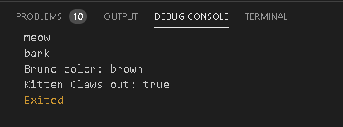
class cat{
void speak(){
print("meow");
}
bool clawsOut(){
return true;
}
}
class dog{
void speak(){
print("bark");
}
String color(){
return "brown";
}
}

Slide 5
Access Specifier
Access specifiers or modifiers(i.e, private, public and protected) are not supported in dart language.
Although to make any class or method private(i.e., access of that specific class or method to have a scope limited to themselves only.) you have to start the function or class name using “_”.

Slide 6
Access Specifier
class house{
//Private
int _age=0;
//Public
String color='White';
int width=0;
int height=0;
void setAge(int a){
_age=a;
}
}
import 'house.dart';
void main(List<String> arguments) {
house house1=new house();
house1.color='Yellow';
house1.width=90;
house1.height=100;
house1.setAge(80);
}

Slide 7
Getter and Setter
class house{
//Private
int _age=0;
//Getter and Setter
set setAge(int a)=>_age=a;
int get yearseOld=>_age; }
import 'house.dart';
void main(List<String> arguments) {
house house1=new house();
house1.setAge=99;
print(house1.yearseOld);
}

Slide 8
Constructors
Every class has default constructor.
It is used to initialize the variable before it is used.
import 'house.dart';
void main(List<String> arguments) {
house house1=new house(90,80);
}
class house{
int width=0;
int height=0;
house(int w,int h){
width=w;
height=h;
print("Constructed: ${width},${height}");
}
}

Slide 9
Garbage Collector
Dart does not have concept of de-constructor.
It has Garbage collector which automatically dispose all the objects.
import 'house.dart';
void test(){
house house1=new house(90,80);
house1.dispose();
}
void main(List<String> arguments) {
test();
}
class house{
int width=0;
int height=0;
house(int w,int h){
width=l;
height=h;
print("Constructed: ${width},${height}");}
//manual disposing the objects
void dispose(){
print("Shut me down");
}}

Slide 10
Extending Classes
class animal{
bool hasEye()=>true;
bool hasMouth()=>true;
void test(){
print('Animal has eye:${hasEye()}');
print('Animal has Mouth:${hasMouth()}');
}
}
import 'animals.dart';
class rabbit extends animal{
bool isFast()=>true;
bool eatCarrot()=>true;
@override
void test() {
print('Rabbit is fast:${isFast()}');
print('Rabbit eats carrot ${eatCarrot()}');
super.test();
}
}

Slide 11
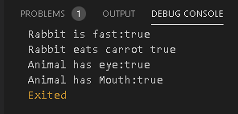
Extending Classes
import 'rabbit.dart';
void main(List<String> arguments) {
rabbit().test();
}

Slide 12
Thank You

